Slide 1
Chapter 3
The Relational Database Model

Slide 2
Learning Objectives
In this chapter, you will learn:
That the relational database model offers a logical view of data
About the relational model’s basic component: relations
That relations are logical constructs composed of rows (tuples) and columns (attributes)
That relations are implemented as tables in a relational DBMS

Slide 3
Learning Objectives
In this chapter, you will learn:
About relational database operators, the data dictionary, and the system catalog
How data redundancy is handled in the relational database model
Why indexing is important

Slide 4
A Logical View of Data
Relational database model enables logical representation of the data and its relationships
Logical simplicity yields simple and effective database design methodologies
Facilitated by the creation of data relationships based on a logical construct called a relation

Slide 5
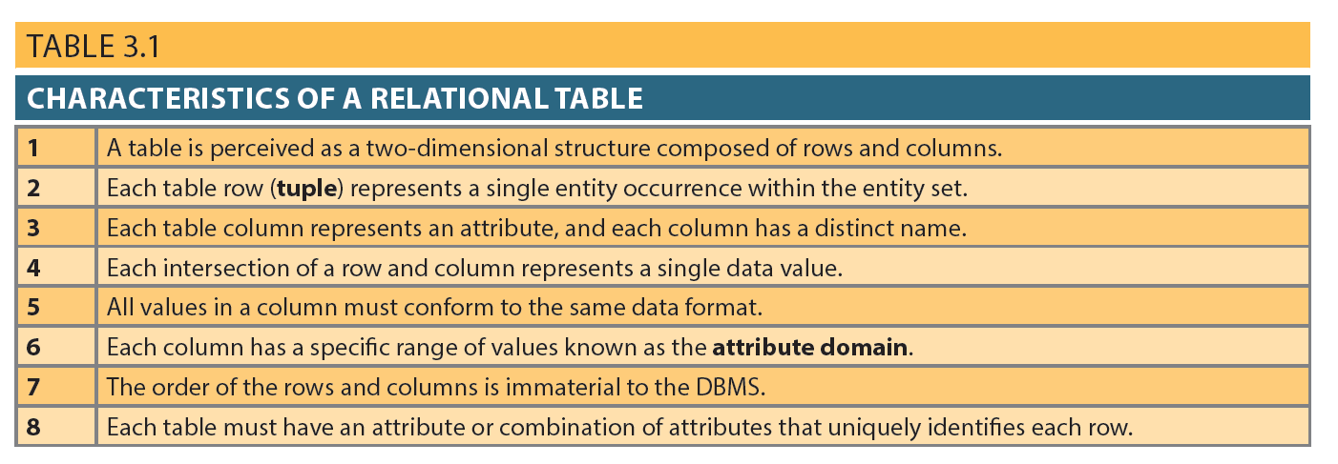
Table 3.1 - Characteristics of a Relational Table

Slide 6
Keys
Consist of one or more attributes that determine other attributes
Used to:
Ensure that each row in a table is uniquely identifiable
Establish relationships among tables and to ensure the integrity of the data
Primary key (PK): Attribute or combination of attributes that uniquely identifies any given row

Slide 7
Determination
State in which knowing the value of one attribute makes it possible to determine the value of another
Basis for establishing the role of a key
Based on the relationships among the attributes

Slide 8
Dependencies
Functional dependence: Value of one or more attributes determines the value of one or more other attributes
Determinant: Attribute whose value determines another
Dependent: Attribute whose value is determined by the other attribute
Full functional dependence: Entire collection of attributes in the determinant is necessary for the relationship

Slide 9
Types of Keys
Composite key: Key that is composed of more than one attribute
Key attribute: Attribute that is a part of a key
Entity integrity: Condition in which each row in the table has its own unique identity
All of the values in the primary key must be unique
No key attribute in the primary key can contain a null

Slide 10
Types of Keys
Null: Absence of any data value that could represent:
An unknown attribute value
A known, but missing, attribute value
A inapplicable condition
Referential integrity: Every reference to an entity instance by another entity instance is valid
Secondary key: Key used strictly for data retrieval purposes

Slide 11
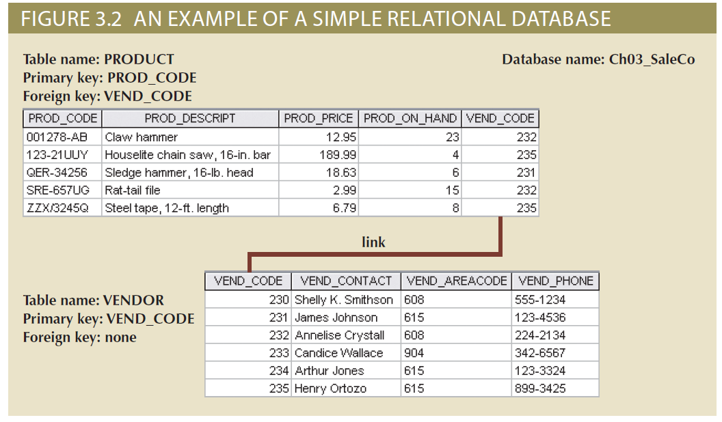
Figure 3.2 - An Example of a Simple Relational Database

Slide 12
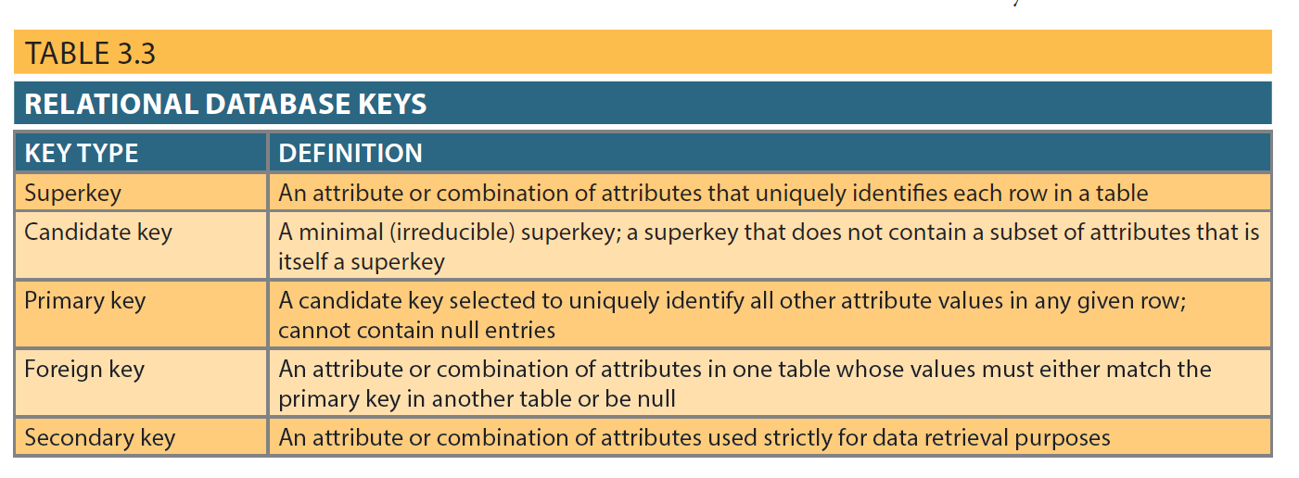
Table 3.3 - Relational Database Keys

Slide 13
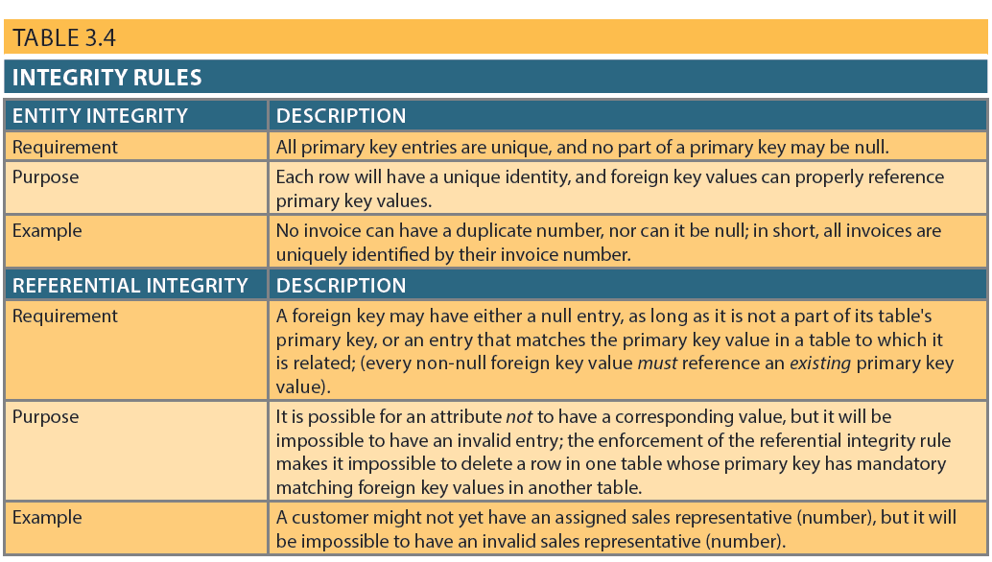
Integrity Rules

Slide 14
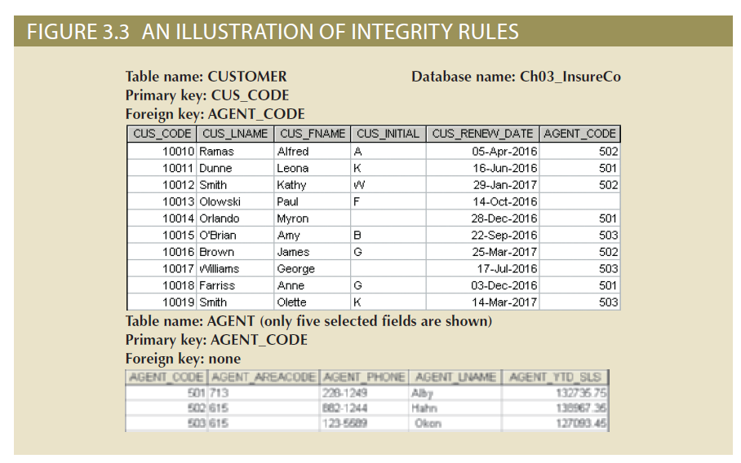
Figure 3.3 - An Illustration of Integrity Rules

Slide 15
Ways to Handle Nulls
Flags: Special codes used to indicate the absence of some value
NOT NULL constraint - Placed on a column to ensure that every row in the table has a value for that column
UNIQUE constraint - Restriction placed on a column to ensure that no duplicate values exist for that column

Slide 16
Relational Algebra
Theoretical way of manipulating table contents using relational operators
Relvar: Variable that holds a relation
Heading contains the names of the attributes and the body contains the relation
Relational operators have the property of closure
Closure: Use of relational algebra operators on existing relations produces new relations

Slide 17
Relational Set Operators
Select (Restrict)
Unary operator that yields a horizontal subset of a table
Project
Unary operator that yields a vertical subset of a table
Union
Combines all rows from two tables, excluding duplicate rows
Union-compatible: Tables share the same number of columns, and their corresponding columns share compatible domains
Intersect
Yields only the rows that appear in both tables
Tables must be union-compatible to yield valid results

Slide 18
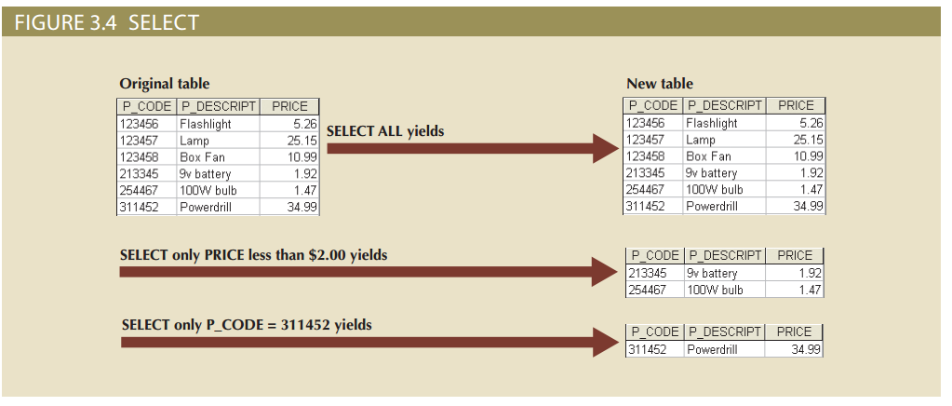
Figure 3.4 - Select

Slide 19
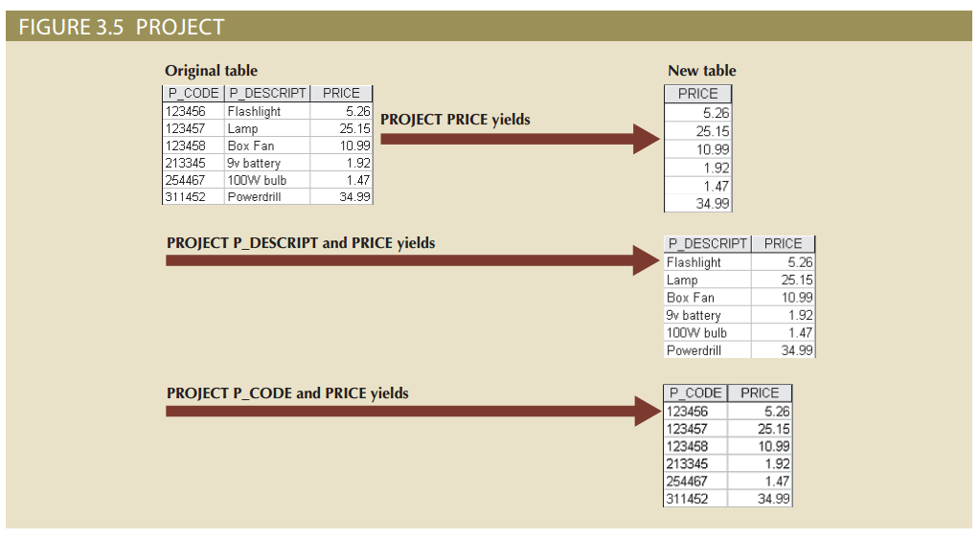
Figure 3.5 - Project

Slide 20
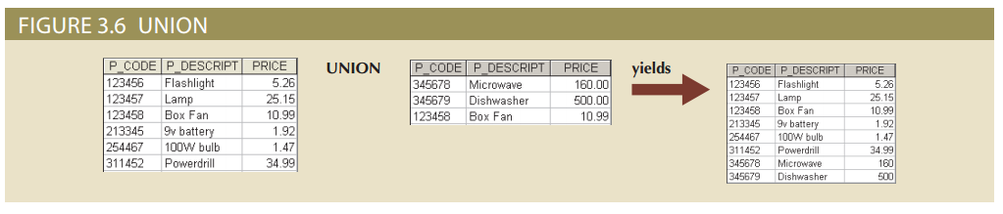
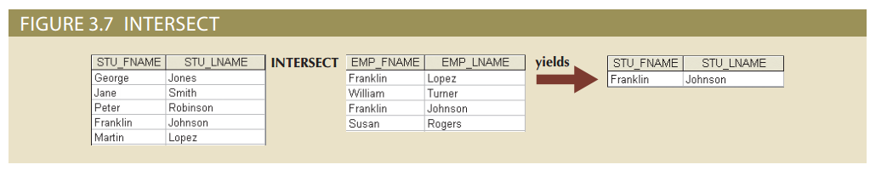
Figure 3.6 - Union and Figure 3.7 - Intersect

Slide 21
Relational Set Operators
Difference
Yields all rows in one table that are not found in the other table
Tables must be union-compatible to yield valid results
Product
Yields all possible pairs of rows from two tables

Slide 22
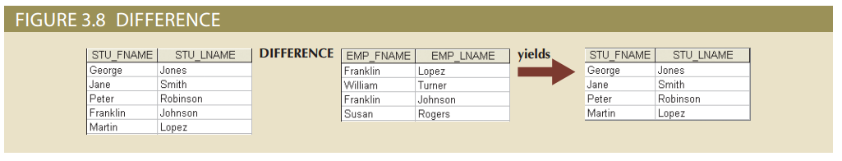
Figure 3.8 – Difference

Slide 23
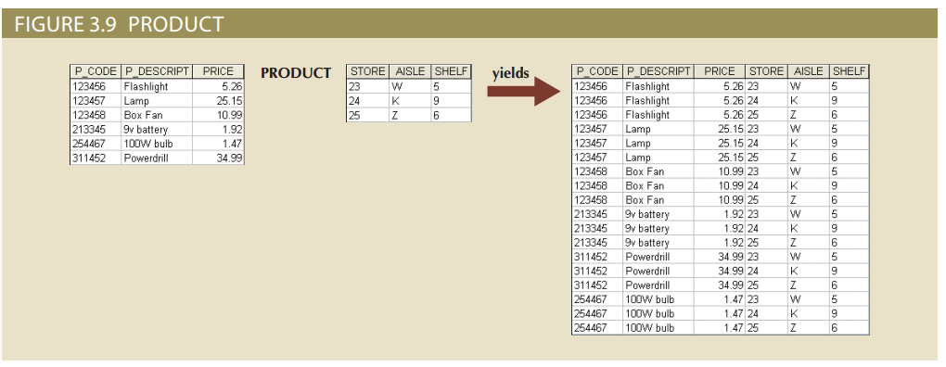
Figure 3.9 - Product

Slide 24
Relational Set Operators
Join
Allows information to be intelligently combined from two or more tables
Divide
Uses one 2-column table as the dividend and one single-column table as the divisor
Output is a single column that contains all values from the second column of the dividend that are associated with every row in the divisor

Slide 25
Types of Joins
Natural join: Links tables by selecting only the rows with common values in their common attributes
Join columns: Common columns
Equijoin: Links tables on the basis of an equality condition that compares specified columns of each table
Theta join: Extension of natural join, denoted by adding a theta subscript after the JOIN symbol

Slide 26
Types of Joins
Inner join: Only returns matched records from the tables that are being joined
Outer join: Matched pairs are retained and unmatched values in the other table are left null
Left outer join: Yields all of the rows in the first table, including those that do not have a matching value in the second table
Right outer join: Yields all of the rows in the second table, including those that do not have matching values in the first table

Slide 27
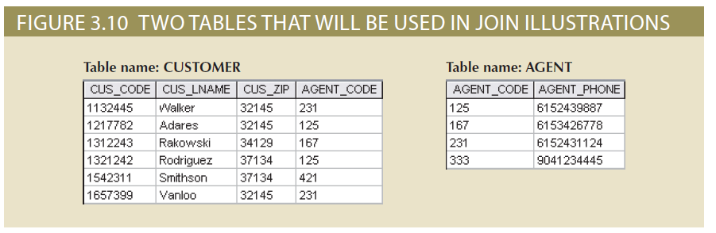
Figure 3.10 - Two Tables That Will Be Used in JOIN Illustrations

Slide 28
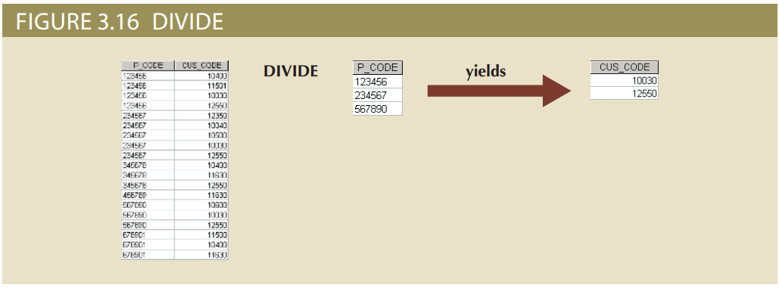
Figure 3.16 - Divide

Slide 29
Data Dictionary and the System Catalog
Data dictionary: Description of all tables in the database created by the user and designer
System catalog: System data dictionary that describes all objects within the database
Homonyms and synonyms must be avoided to lessen confusion
Homonym: Same name is used to label different attributes
Synonym: Different names are used to describe the same attribute

Slide 30
Relationships within the Relational Database
1:M relationship - Norm for relational databases
1:1 relationship - One entity can be related to only one other entity and vice versa
Many-to-many (M:N) relationship - Implemented by creating a new entity in 1:M relationships with the original entities
Composite entity (Bridge or associative entity): Helps avoid problems inherent to M:N relationships, includes the primary keys of tables to be linked

Slide 31

Figure 3.21 - The 1:1 Relationship between PROFESSOR and DEPARTMENT

Slide 32
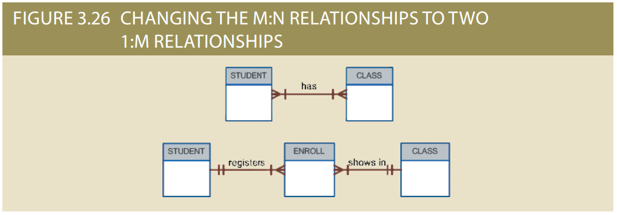
Figure 3.26 - Changing the M:N Relationship to Two 1:M Relationships

Slide 33
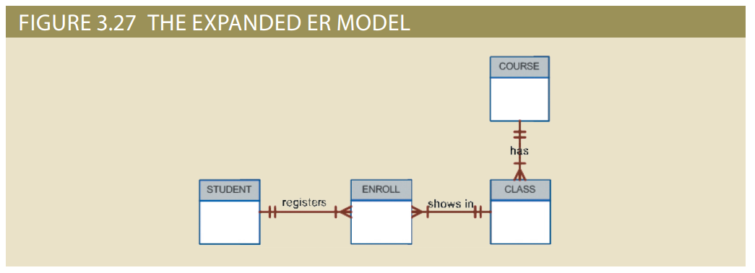
Figure 3.27 - The Expanded ER Model

Slide 34
Data Redundancy Revisited
Relational database facilitates control of data redundancies through use of foreign keys
To be controlled except the following circumstances
Data redundancy must be increased to make the database serve crucial information purposes
Exists to preserve the historical accuracy of the data

Slide 35
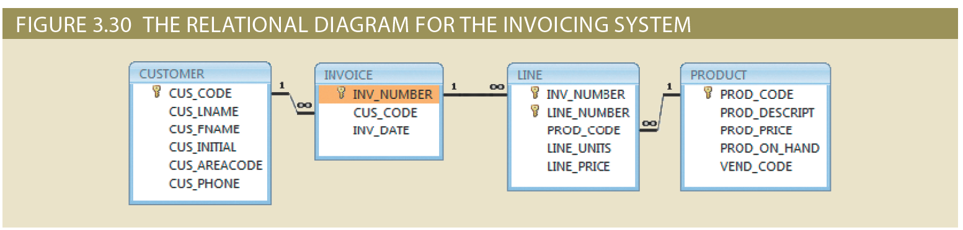
Figure 3.30 - The Relational Diagram for the Invoicing System

Slide 36
Indexes
Orderly arrangement to logically access rows in a table
Index key: Index’s reference point that leads to data location identified by the key
Unique index: Index key can have only one pointer value associated with it
Each index is associated with only one table

Slide 37
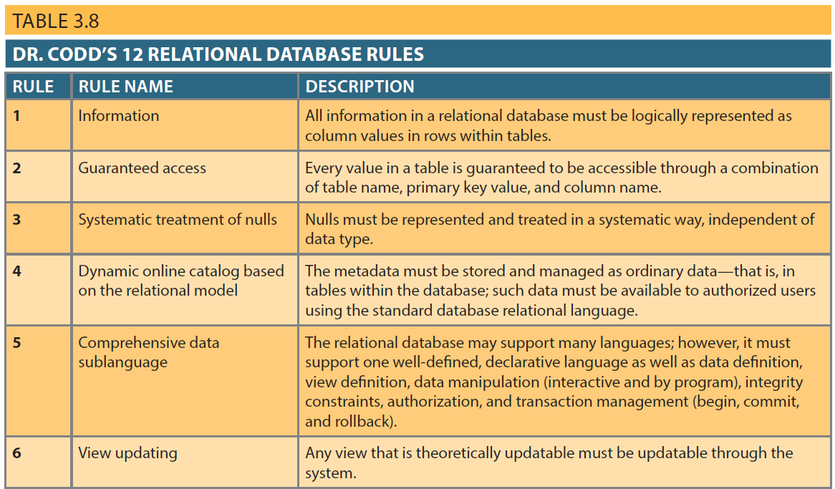
Table 3.8 – Dr. Codd’s 12 Relational Database Rules

Slide 38
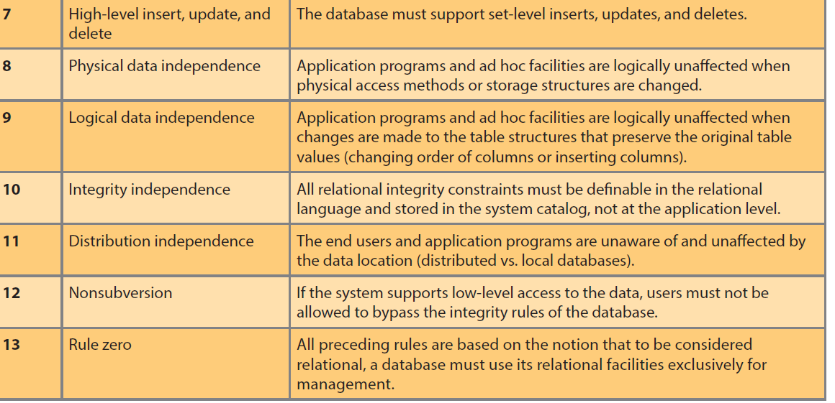
Table 3.8 – Dr. Codd’s 12 Relational Database Rules

